Slide 1




ATIQ GRAND
HOTEL ANALYSIS
Background:
AtliQ Grand owns multiple five-star hotels across India.
They have been in the hospitality industry for the past 20 years.
They are losing market share and revenue in the luxury/business hotels category due to strategic moves by competitors and ineffective decision-making.
Current Situation:
The managing director wants to regain market share and revenue.
The revenue management team has decided to hire a third-party service provider to get insights from their historical data.
Role:
You are the data analyst provided with sample data to offer revenue insights to the team

Slide 2
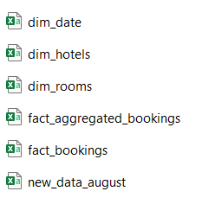
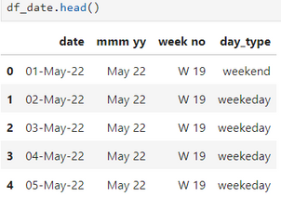
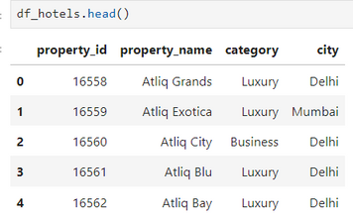
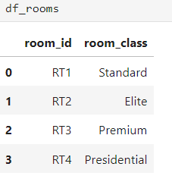
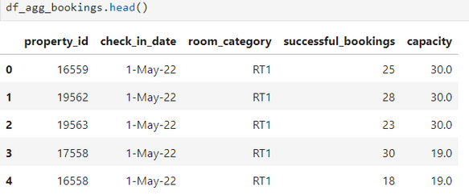
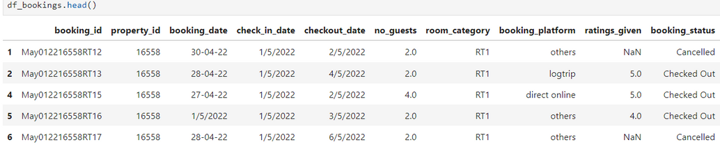
About Dataset
Data Provided:
3 months of booking data from AtliQ Grand, containing around 1.4 lakh (140,000) records.
Dataset Structure:
The dataset includes 3 dimension tables and 2 fact tables.
Additional Data:
August month data was also provided to be included in the previous data.
Importing Dataset

Slide 3
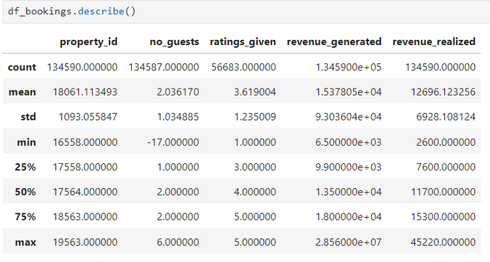
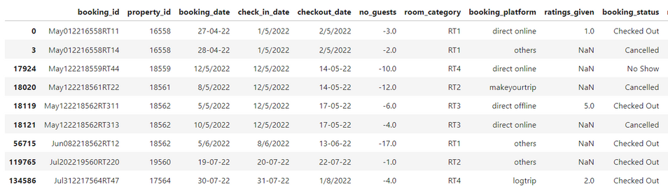
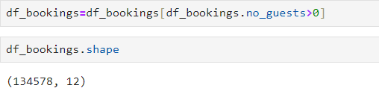
Data Cleaning
df_bookings table no_guets column indicates a data quality issue: the minimum number of guests in the dataset is negative, which is not a valid value.
To address this issue:
Data Cleaning:
Identify and filter out records with negative values for the number of guests.
Check for any other anomalies or invalid values in the dataset.
Since rows containing a negative number of guests are fewer compared to the total rows, we can ignore them for insight generation. So, keep the rows which have a positive number of guests

Slide 4
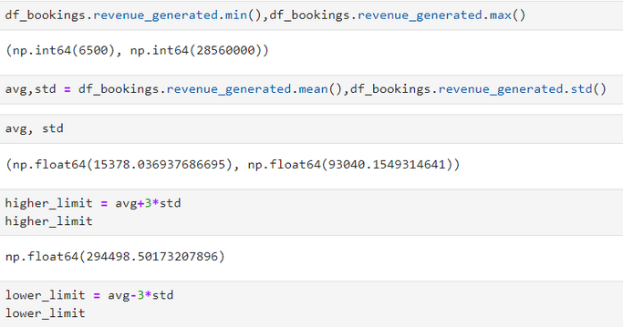
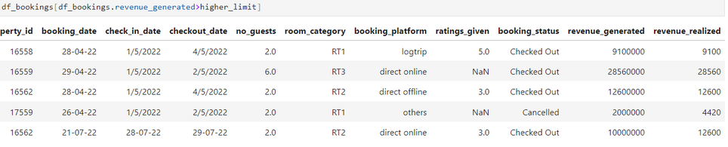
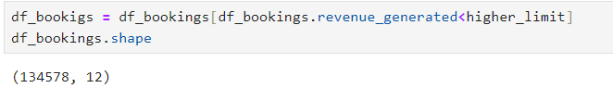
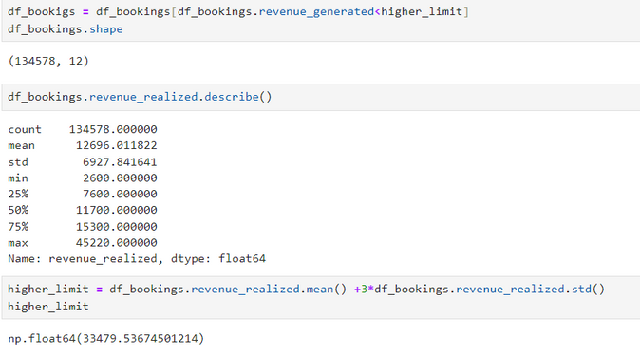
Data Cleaning
We have no negitive values in rev_generated column
Since we have only 5 outliers, we can ignore them
Outlier remove in revenu_generated

Slide 5
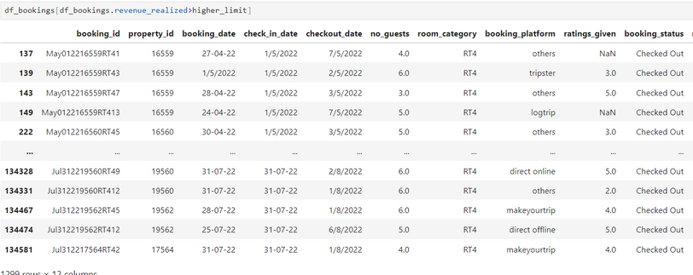
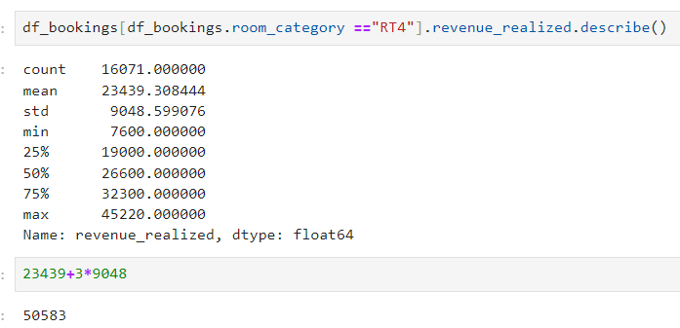
Data Cleaning
One observation we can have in the above dataframe is that all rooms are RT4 type which means Presidential Suite. Now, since RT4 is a luxurious room, it is likely their rent will be higher. To make a fair analysis, we need to do data analysis only on RT4 room type
Here higher limit comes to be 50583 and in our dataframe above we can see that max value for revenue realized is 45220. Hence we can conclude that there is no outlier and we don't need to do any data cleaning on this particular column.

Slide 6
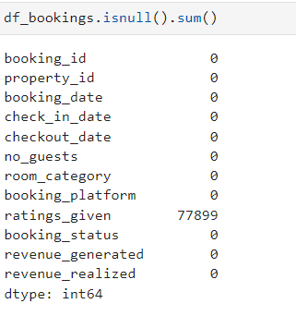
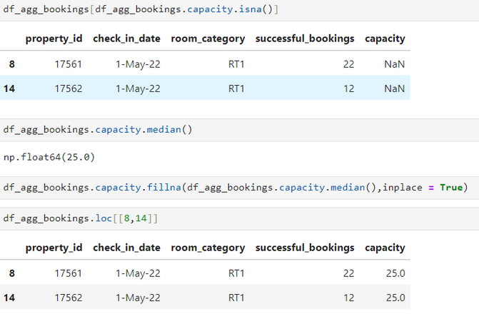
Data Cleaning
Null values in ratings_given column
Since it is logical that every customer doesn't provide a rating, our ratings_given column can have null values.
Null values in df_agg_bookings
5

Slide 7
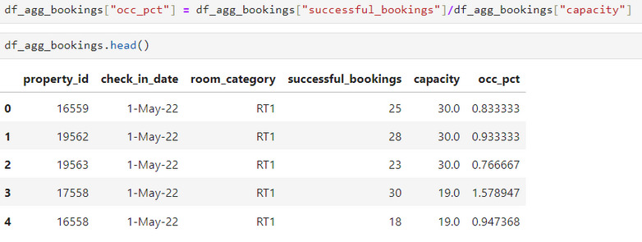
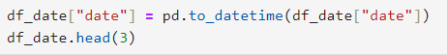
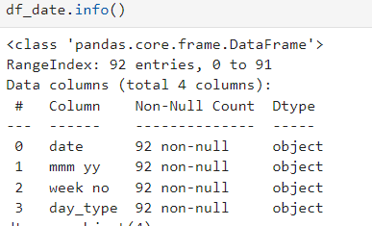
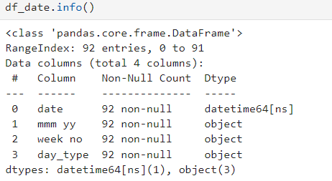
Data Transformation
Transforming data involves cleaning, integrating, and converting it into a more useful format to enhance accuracy and usability. This process ensures data is ready for in-depth analysis and insight extraction. By preparing data thoroughly, analysts can derive more meaningful and actionable insights.
Create Occupancy Percentage Column
Convert object to Datetime format

Slide 8
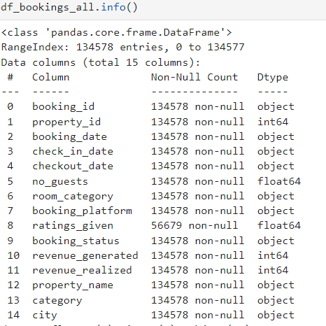
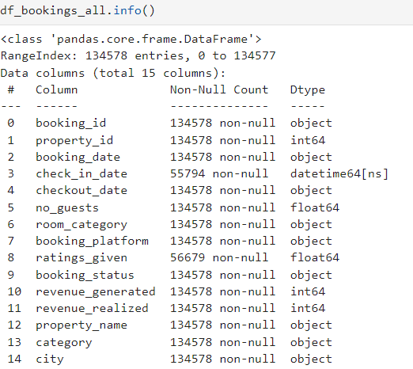
Convert object to Datetime format
\
7

Slide 9
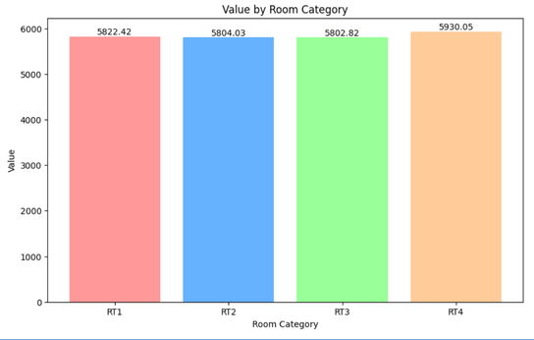
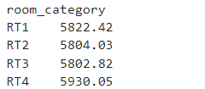
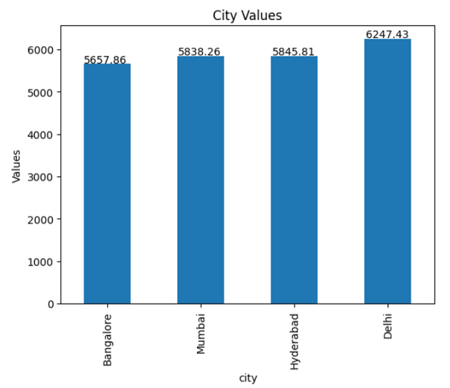
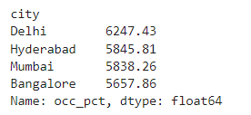
Analysis Insights
Average occupancy rate in each of the room categories
Average occupancy rate in each of the City

Slide 10
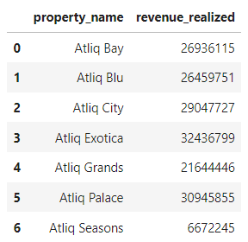
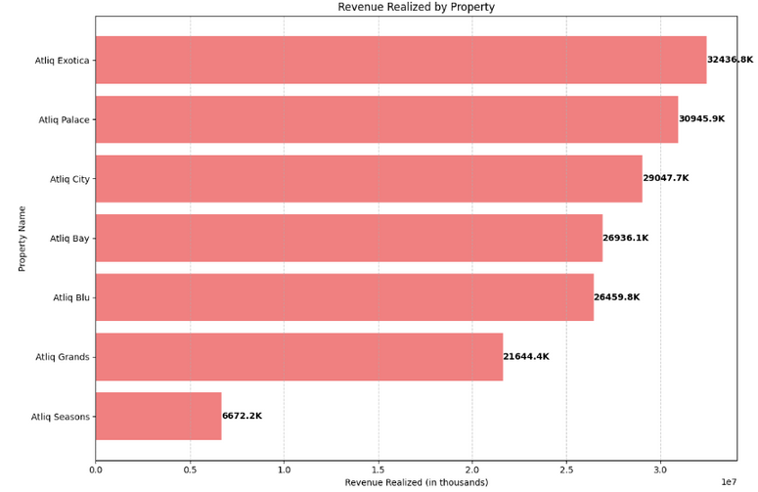
Analysis Insights
Sum of Revenue Realized Per Property Name

Slide 11
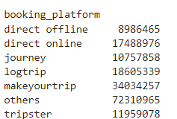
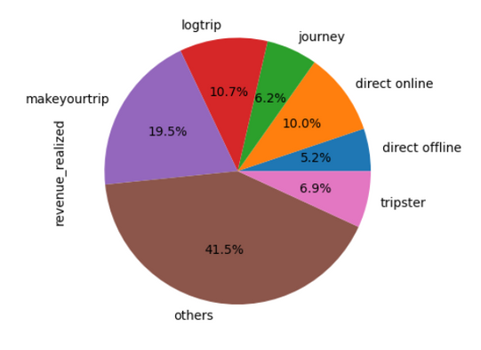
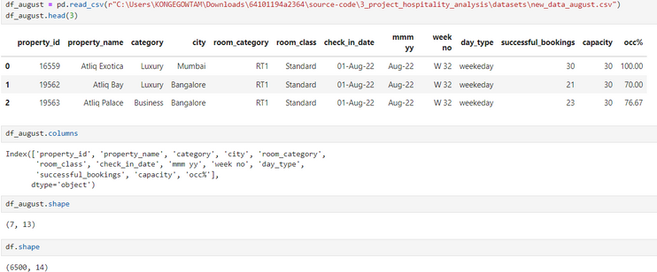
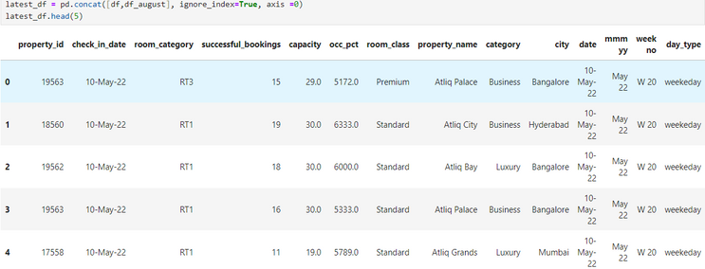
Analysis Insights
Total Percentage of Booking Platforms
New Table Added
We got new data for the month of August , append existing and new table

Slide 12


Thank You
I wanted to take a moment to thank you for taking the time to review my PowerPoint presentation. I sincerely appreciate your valuable feedback and insights.
Your support and input are incredibly helpful, and I am grateful for your guidance.
Thank you once again for your time and consideration.
Best regards,
Gowtam Konge

